Slide 1
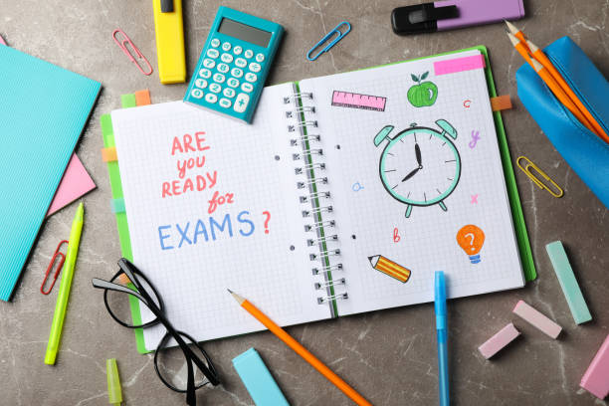
Y10 PPE 2 – Key Information and Logistics
Thursday 13th June
Notes:
Good morning Year 10 and welcome to our first official raising attainment assembly together.

Slide 2
Today’s Assembly
Information about the PPE Timetable & Logistics
Exam Rooms & Equipment
GCSE Rules & Regulations
How to prepare for your PPEs
Notes:
In today’s assembly I will be focusing on three key areas:
Firstly, I want to talk you through what your Y10 raising attainment journey has look liked so far and what’s still to come for the remainder of the year and as you move into Y11
I’m then going to introduce you to your Raising attainment mantra and the reasons behind choosing it
And lastly I’m going to talk to you about receiving your Core PPE Results

Slide 3
PPEs – Key Information Monday 17th June – Thursday 4th July
PPE timetable completed and distributed in tutor time yesterday.
Normal lessons to resume around your exams – includes Prep and Reteach around exams
Full exam arrangements in place for all students (unless an ‘in class exam) – any issues please speak to Miss Forster
If there is a morning exam, we will be meeting in the hall from 8:30am to be registered, hear key information for the day and HOFs will deliver a pre-exam briefing
Breakfast Revision club is on every day at 8am in the LRC (access to computers and revision materials)
C1 is open as a study space every day between 3 and 4pm with the Academic Mentors there to support with any revision.
Revision materials available for all subject areas from your teachers and also, in the common room – speak to Miss Forster or the Academic Mentors (Miss Garfield/Mr Crenol) for access to these.

Slide 4
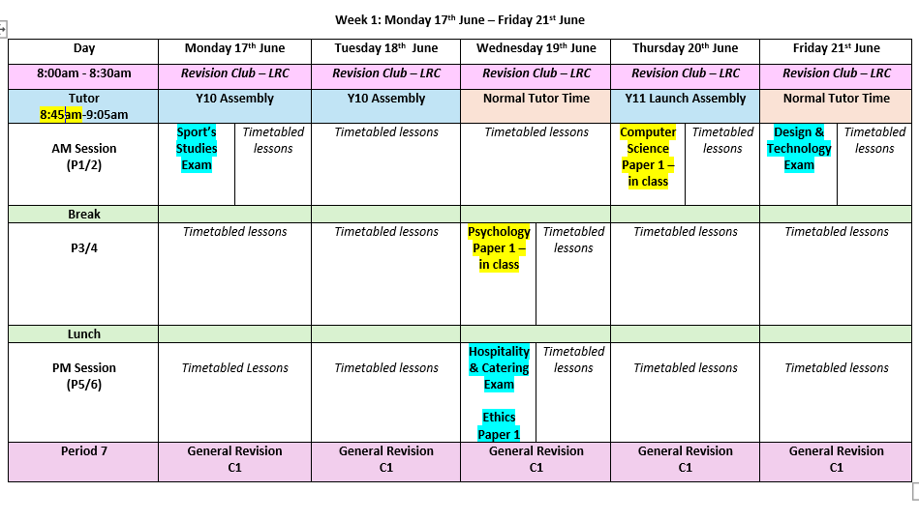
Timetable

Slide 5
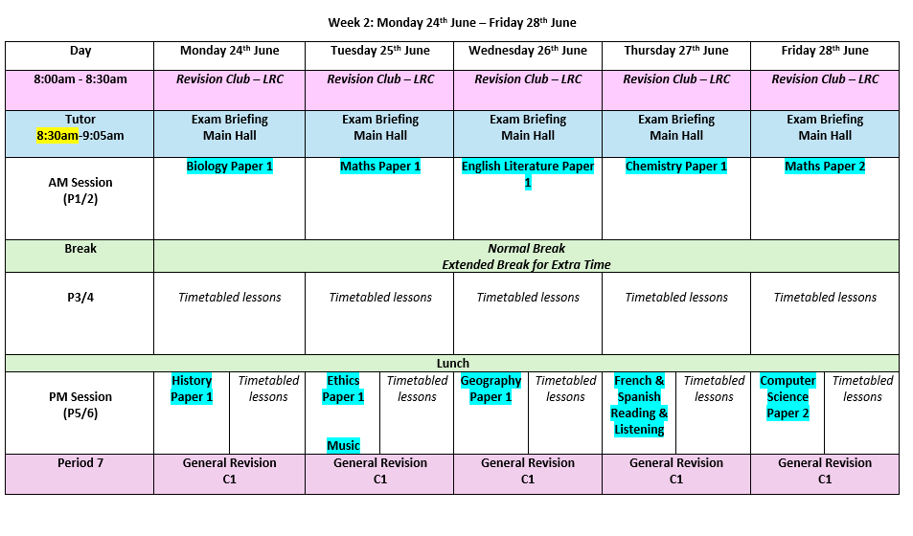

Slide 6
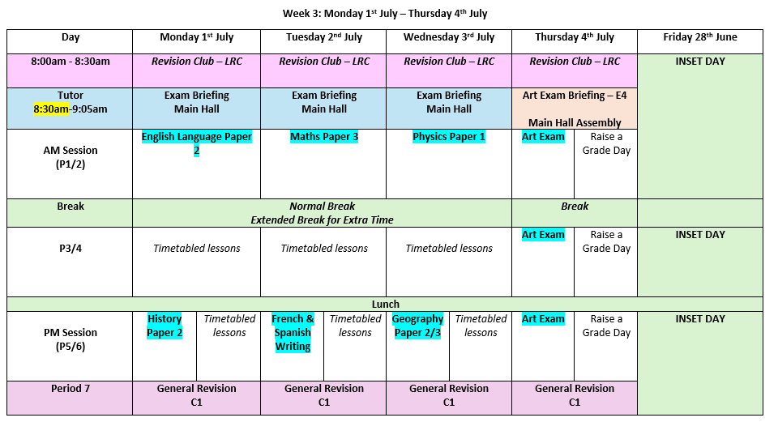

Slide 7
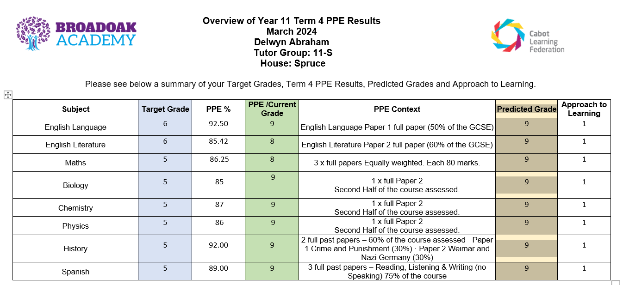
Example Report – Shared in September 2024 (data deadline is the end of the school term

Slide 8
GCSE Exam Rooms
During the summer exam window, we will be using the following spaces:
Sport’s Hall / Dance Studio
E2 / E3 / E4 - To access the E rooms, you must enter via D-wing. No students are permitted to walk through the atrium to access their rooms.
1:1’s - If you have 1:1 you will be using small offices across the academy. Meet your invigilator who will escort you to your exam space.
AM – dining hall
PM – dining hall
Any issues you must speak to Miss Forster or Mrs Lovell (Exams Officer) only

Slide 9
Attendance to exams
ALL students are expected in for the PPE window. We will be pushing for full attendance.
There will be no resits taking place in these exam windows – Resits do not take place in the GCSE window.

Slide 10
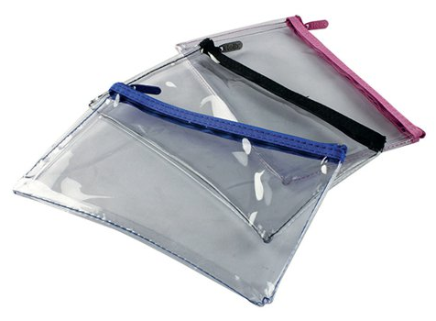
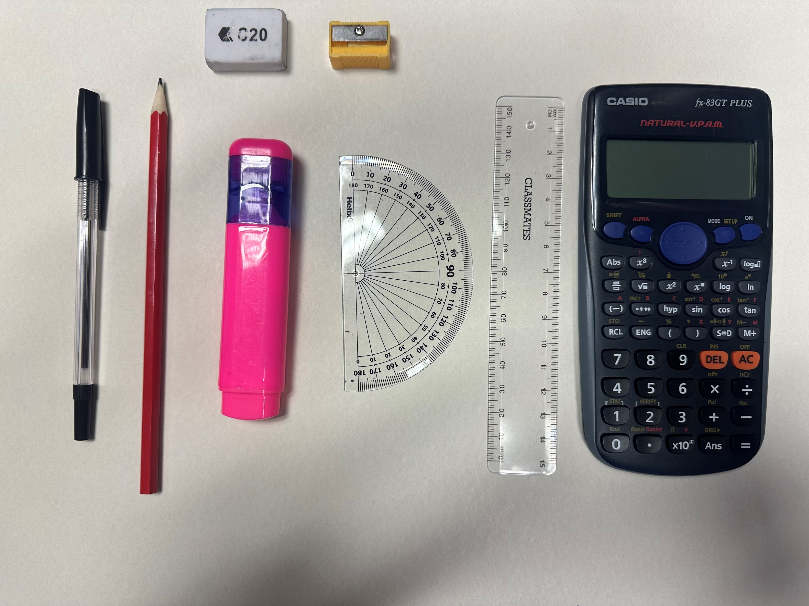
To be exam ready, you need to be equipment ready!
To access all their exams fully students are required to have the following equipment.
A clear pencil case which includes:
Black Ballpoint Pen – NO GEL PENS/NO FELT TIPS
Highlighter (any colour)
Protractor
Pencil
Ruler - 15cm +
Rubber
Sharpener
Casio Scientific Calculator – link to a recommendation on SMHW
Water bottles: You are only allowed to bring in a clear water bottle to the exam with no label.
If they are missing any equipment, they please ensure you ask the invigilator when you arrive to your exam space.

Slide 11
Legal Requirement
The following guidance is a legal requirement from the JCQ (Joint Council of Qualifications) – they oversee all exam boards.
Failure to comply with any of the following could result in malpractice and have a serious impact on either yours or your peers GCSE results. Malpractice in an exam often results in disqualification.
All parents/carers and students should have read the Exam Conduct Letter which outlines all the full details.

Slide 12
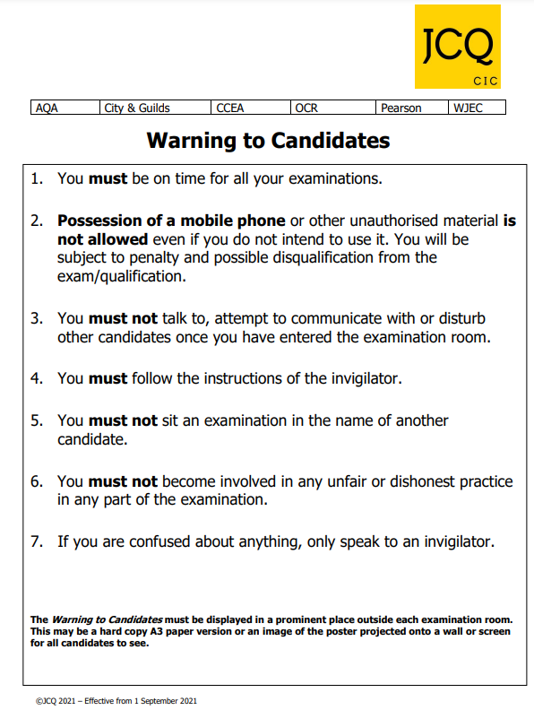
GCSE Exam Rules and Regulations
It is important to follow all guidance in your exams and this includes the following outlined on these posters:
Prohibited items:
Phones
Airpods / headphones
Watches (all types)
Other devices / technology
Other regulations you must follow:
Nothing in your pockets – paper / equipment / devices
No coats / hoodies worn in the exam room
Clear water bottles only

Slide 13
Exam Conditions from the moment you ENTER your exam room
Check your stationery and your exam paper – EVERY EXAM – You must make an invigilator aware if there is anything wrong (tiering, subject etc.)
Fill in the front of your Exam paper, EVERY TIME - Candidate number, Centre Number, Full Name.
Students will laptops /reading pens have been briefed on how to use the devices to ensure everything is done correctly. Speak to an invigilator if you have any concerns.

Slide 14
Toilet Breaks
As much as possible, please try to use the toilet before your exam is due to start.
This doesn’t mean use the toilet, between tutor and your exam as you’ll arrive late. Go before you come to the main hall and during your extended lunch.
You are only permitted to go to the toilet, after the first 30 minutes of the exam has begun.
You will not be allowed out of the room 30 minutes before the end of the exam.
If you have a medical condition the invigilators should be aware.

Slide 15
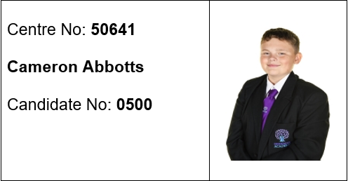
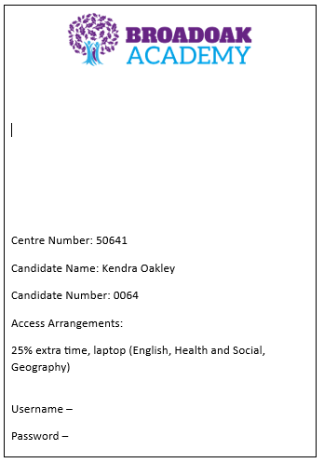
Exam Packs & Candidate Cards
Candidate Cards:
These have the school’s Centre number and each student’s unique exam number on. They also have your photograph on and will always remain on your exam desk so you can be clearly identified by the invigilators.
Students need to make sure that for EVERY exam they fill in the paper with their full name, the centre number and your unique exam number. This is essential so your papers can be marked correctly by exam board examiners and your teachers.
Exam Packs:
If you have Access Arrangements, then you will be given an exam pack in your exam space which will include the pencil case /candidate card and your exam papers. This will be on the desk for them when they enter the room.
DO NOT DEFACE THESE ITEMS AS THEY ARE REQUIRED FOR SAFEGUARDING DURING YOUR EXAMS. THERE WILL BE A CONSEQUENCE IF THERE IS DAMAGE DONE TO THESE CARDS

Slide 16
Student Room and Seating Plan Lists
Lists of your examination room will be put up in the main hall/canteen for you to see prior to your exams.
Please ensure that you look at this carefully so that you are not arriving late to your exam (particularly in the afternoon) and disrupting things for other students.
DATE: XXXXX
SUBJECT & LENGTH: MATHS - 1 HOUR 30 MINUTES
*IF YOU HAVE EXTRA TIME – IT WILL HAVE BEEN ADDED TO YOUR FINISH TIME*
Legal Surname | Legal Forename | Exam No | Start Time | Finish Time | Room | Seat
BLOGGS | JOE | 6789 | 11:30 | 12:30 | C3A | 1
SMITH | EMMA | 1234 | 11:30 | 12:45 | C3A | 2

Slide 17
How can you prepare for the PPEs?
Attend school everyday and attend every lesson! This is the best place for you to be to get good outcomes.
Make use of the revision guides & revision materials provided by your teachers.
Get your family/friends to support revision and independent learning where possible.
Check you know when and what the assessments are and be ready for them!
Access extra revision (Period 7 in C1)
Ask if you need help.

Slide 18
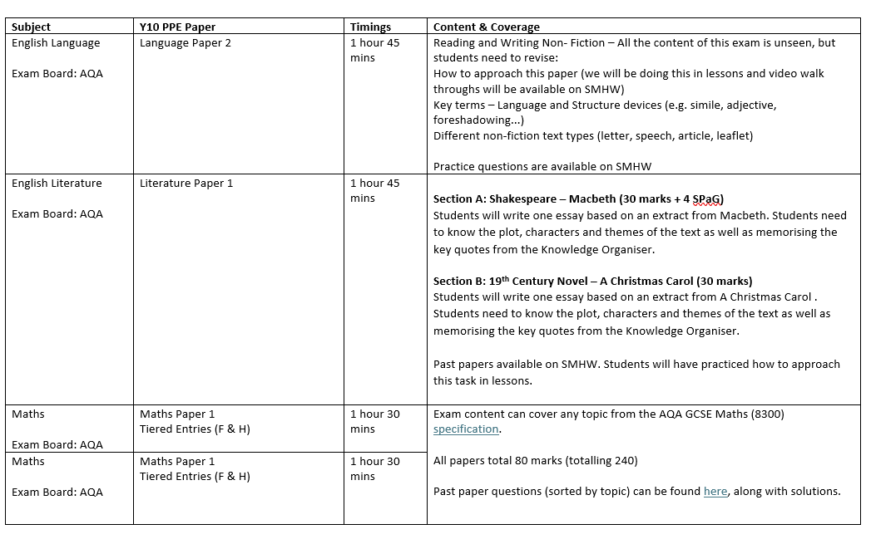
Contents & Coverage

Slide 19
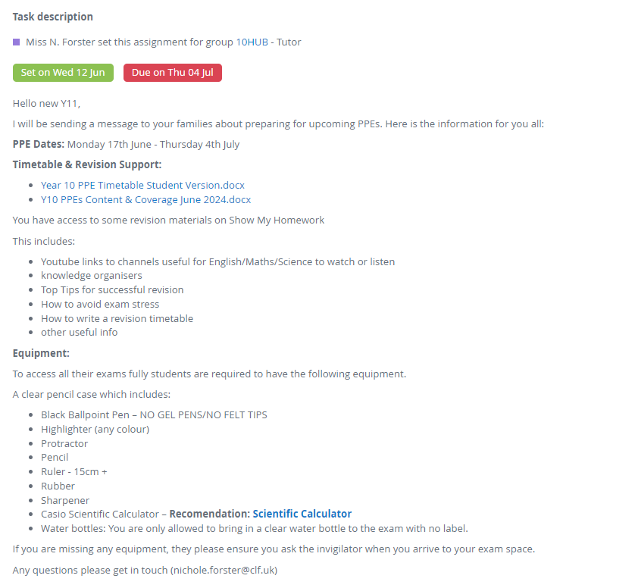
SMHW

Slide 20
What’s next…?
Monday 17th June – Y10 Assembly (Launching Hutton Moor) / Start of PPE Window
Tuesday 18th June – Y10 Assembly (Access Arrangments)
Thursday 19th June – Y11 Launch Assembly
Monday 24th June – Thursday 4th July – Main Hall briefing from 8:30am

Slide 21
Questions or Concerns?
If you have any questions or worries, please speak to your tutor, member of the student support team (key worker) or Miss Forster (email: nichole.forster@clf.uk)

